Slide 1
Topics to be Covered
Ordinary Generating Functions
  Definition
Operations on
    Scaling
    Addition
    Shifting
    Differentiation
    Convolution

Slide 2
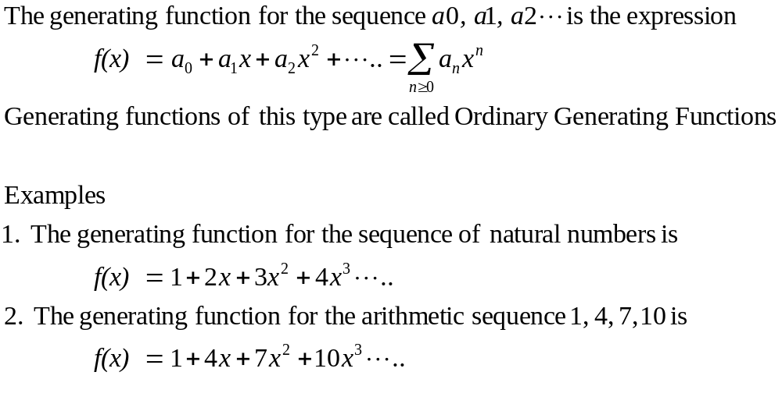
Generating Functions

Slide 3
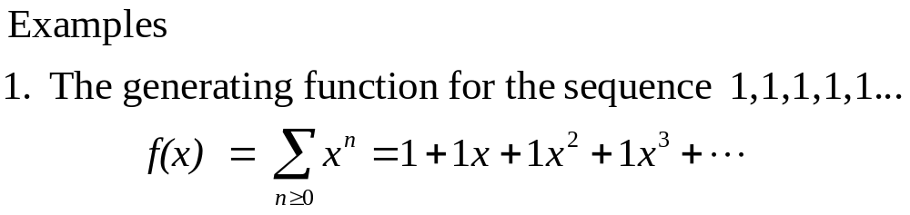
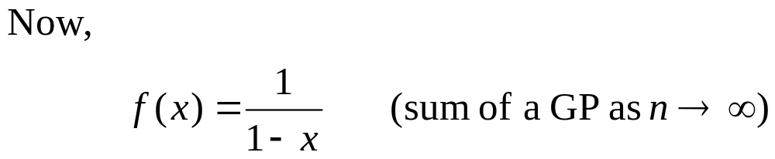
Special examples
Recall… If r lies between -1 and +1, i.e. |r|<1, the r^{n} approaches zero as n increases, and the sum to infinity of the GP
a + ar +ar²+…+ar^{n-1}+… = a / (1-r)

Slide 4
Determining Generating Functions for Sequences
How can we manipulate generating functions so that we may find out generating functions for other sequences.
Lets now look at some operations on and the algebra of generating functions

Slide 5
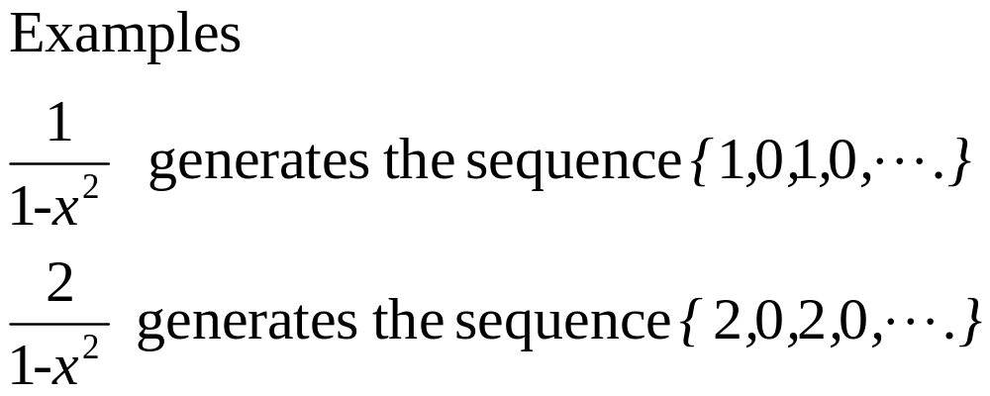
Scaling
Scaling - multiplying a generating function by a constant scales every term in the associated sequence by the same constant.

Slide 6
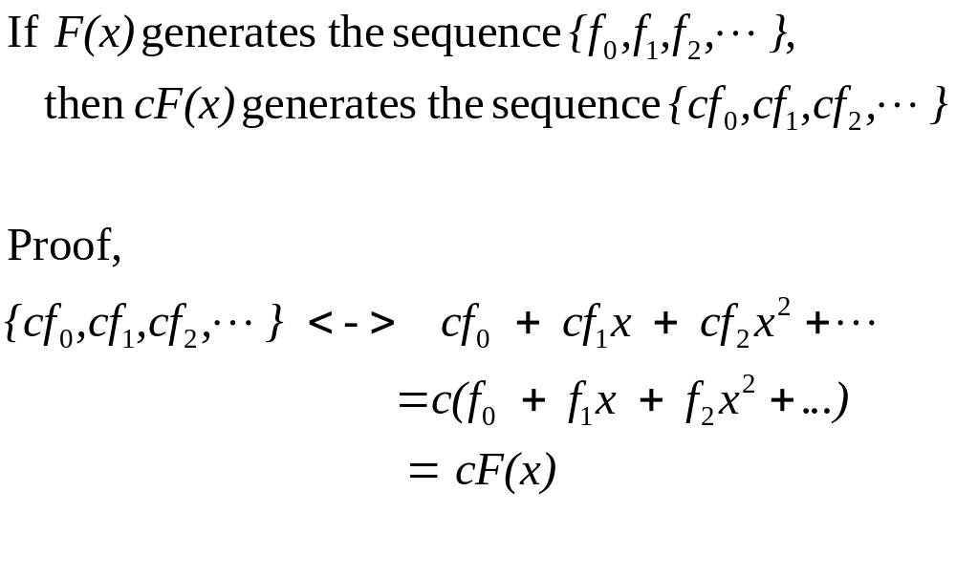
Scaling Rule

Slide 7
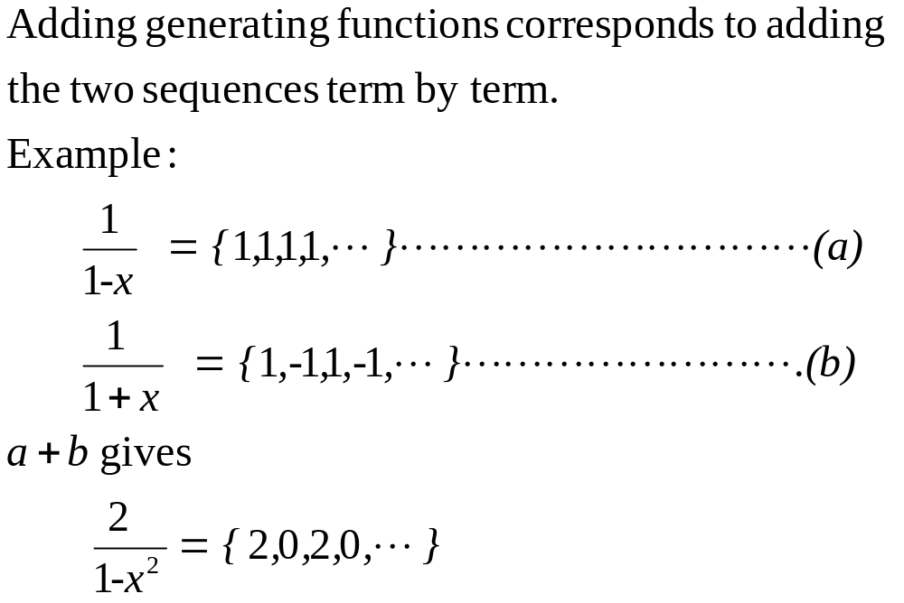
Addition Rule

Slide 8
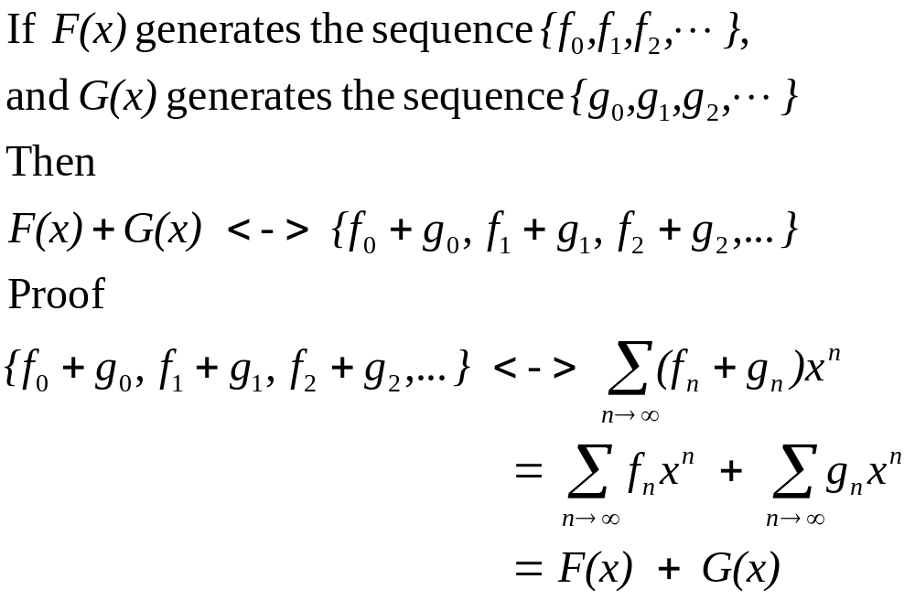
Addition Rule

Slide 9
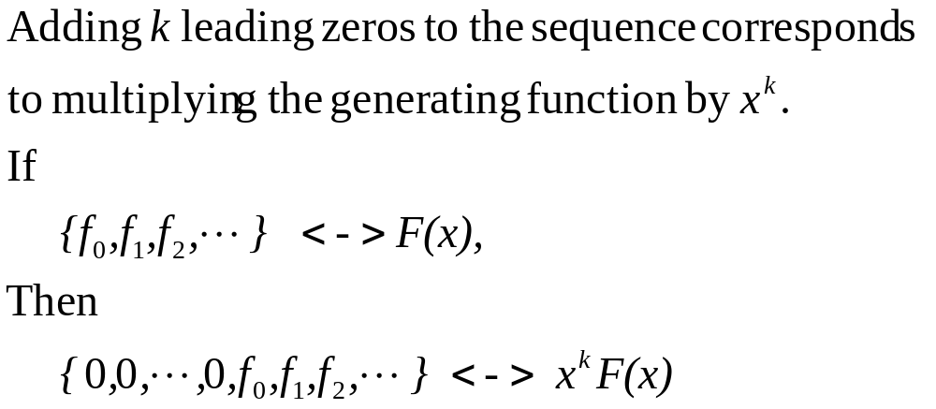
Right Shifting
k

Slide 10
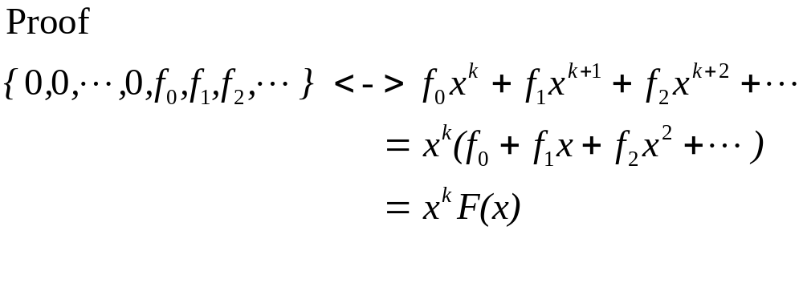
Right Shifting
k

Slide 11
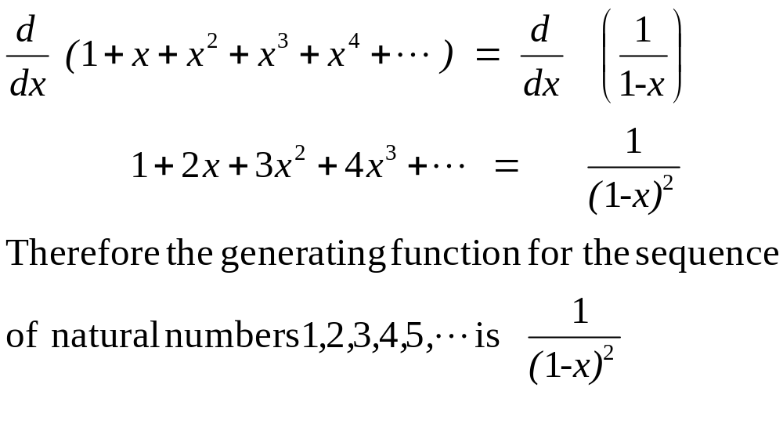
Differentiation

Slide 12
Differentiation
In general, differentiating a generating function has two effects on the corresponding sequence:
1. Each term is multiplied by its index
2. The entire sequence is shifted left one
place

Slide 13
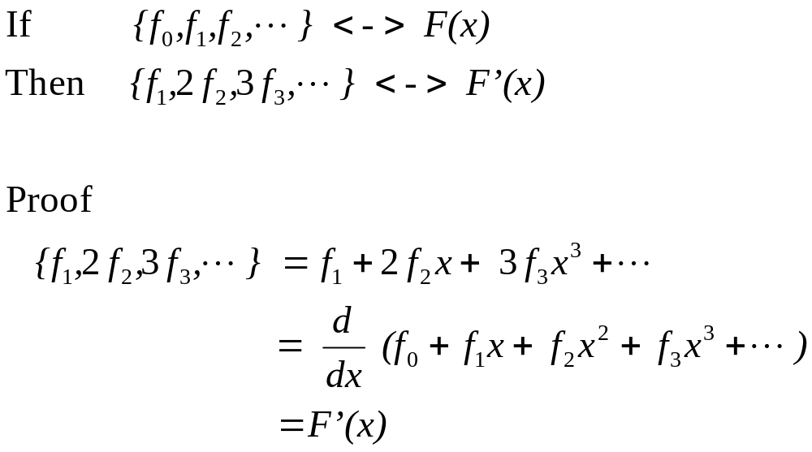
Differentiation

Slide 14
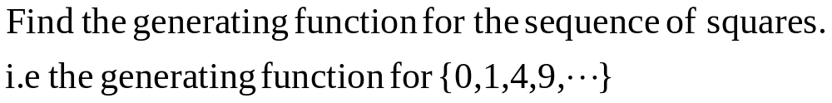
Example – Determining the Generating function for a sequence

Slide 15
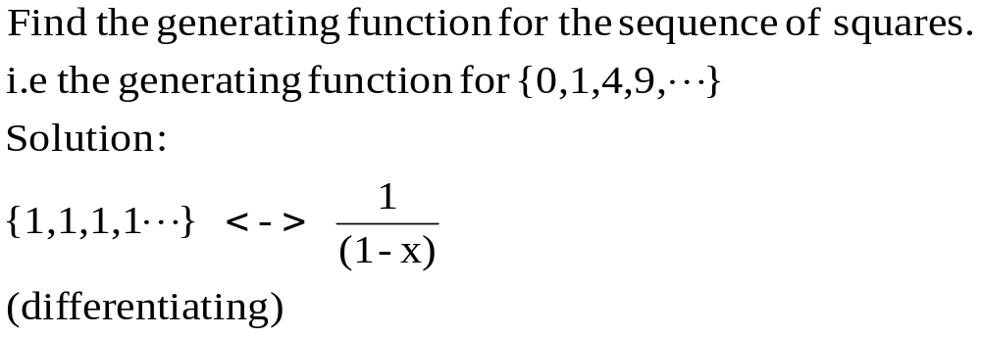
Example – Determining the Generating function for a sequence

Slide 16
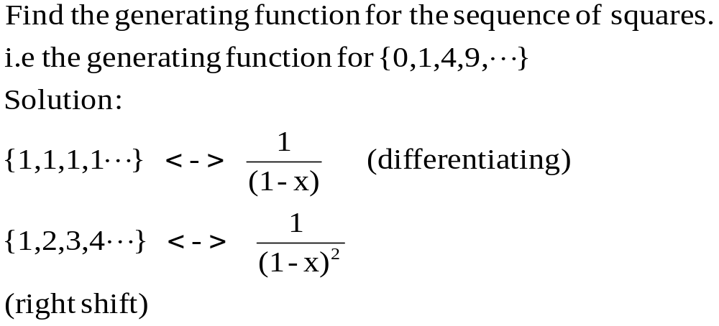
Example – Determining the Generating function for a sequence

Slide 17
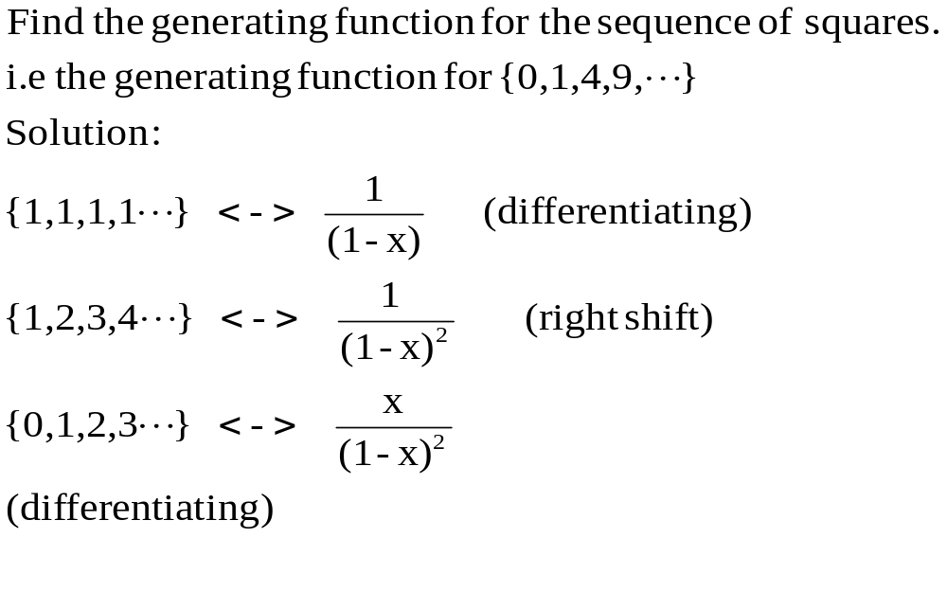
Example – Determining the Generating function for a sequence

Slide 18
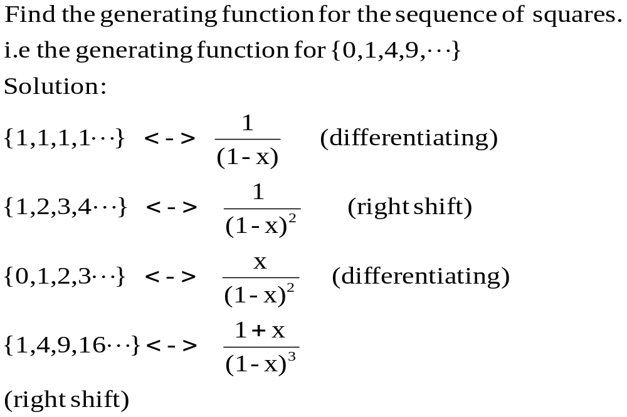
Example – Determining the Generating function for a sequence

Slide 19
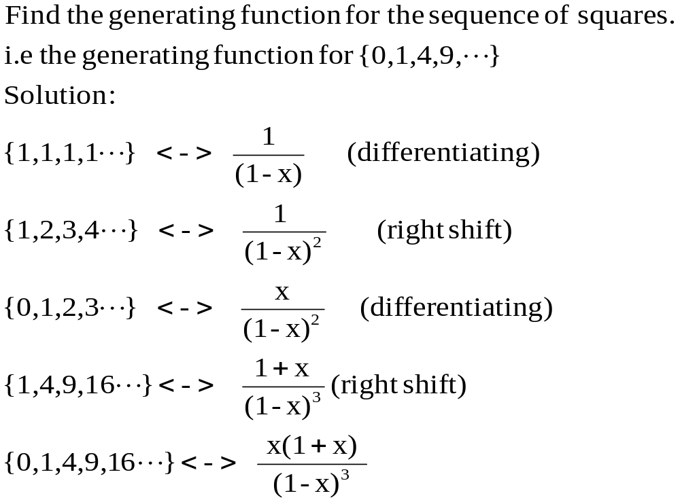
Example – Determining the Generating function for a sequence

Slide 20
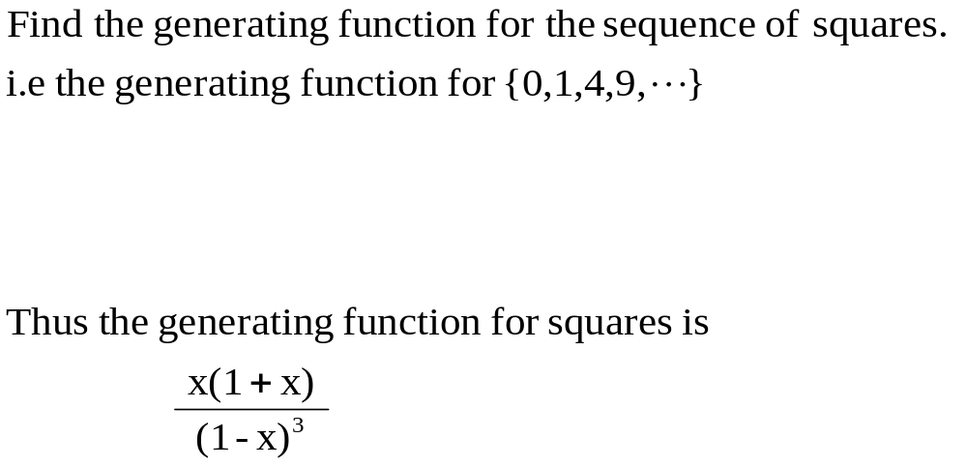
Example – Determining the Generating function for a sequence

Slide 21
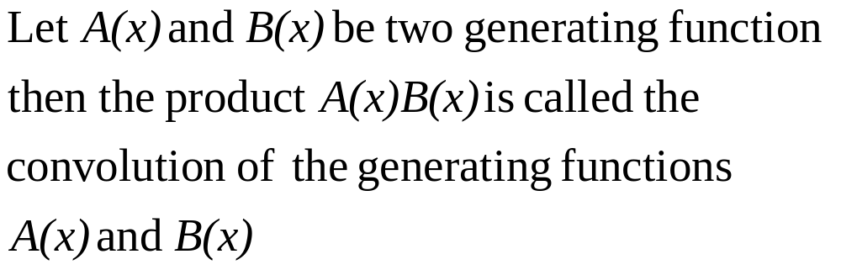
Convolution of Generating Functions

Slide 22
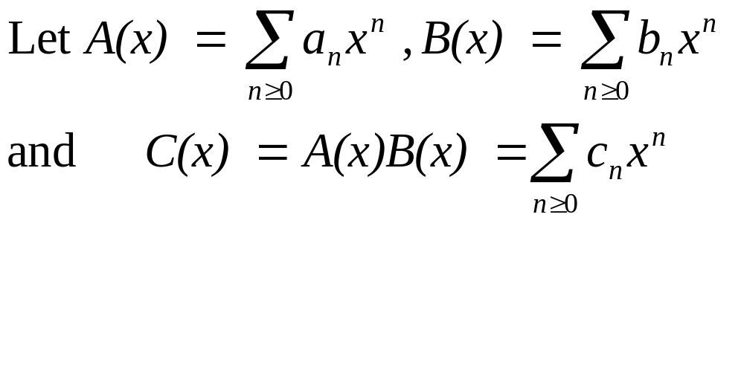
Convolution

Slide 23
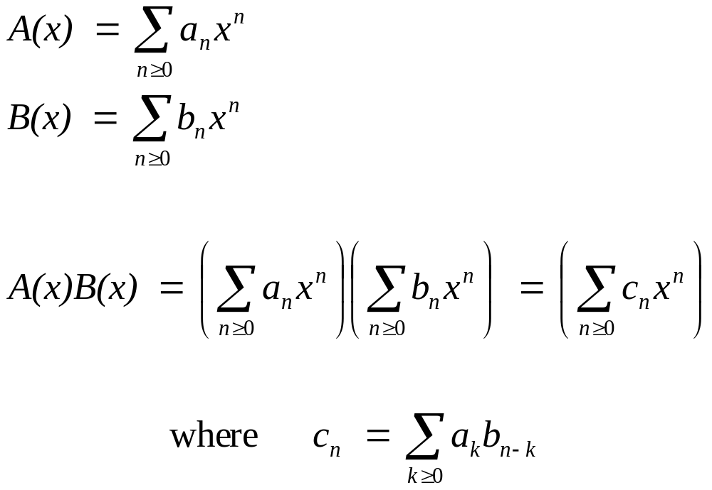
Convolution Rule

Slide 24
Topics Covered
Ordinary Generating Functions
  Definition
Operations on
    Scaling
    Addition
    Shifting
    Differentiation
    Convolution

